Slide 1

Healthcare
Accum Hub – Bi-weekly touchpoint
Version 1, May 2015

Slide 2
Vision
WGS Accum ODS
Accum ODS should function like a financial system with consistency and sanctity of the transactions
Treat the Accum hub like a microservice to gain autonomy and maintain isolation from other systems changes

Slide 3
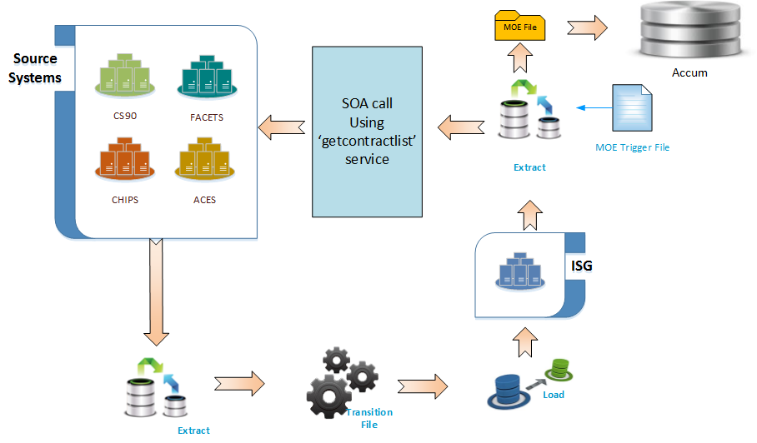
MOE File – Consistency Issue
Eliminate out of sync issues
Problem Statement
MOE file is using service ‘getContractList’
which doesn’t handle exception during calls to legacy
E&B systems resulting in inconsistent data. This creates out of synch situations on member accum data.
Two solutions
1. Use full batch file from Transition (TR) Team, Dependency with TR team
2. Use membership microservices planned for October release, data is fetched from consumber hub which is consistent and reliable.
Out of synch situations are eliminated or reduced.
Solution Highlights
Benefits
3

Slide 4
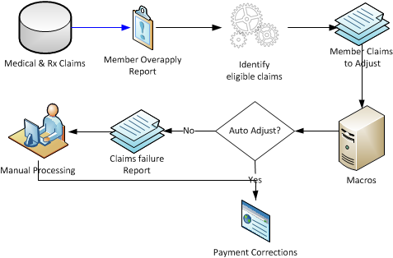
Automate manual adjustments for RX over-apply accumulators
Automation
Problem Statement
Member accumulators are over applied due to out of sync scenarios between medical and Rx
Member accumulator over-apply reports are generated and it is manually reviewed by operations to identify the claims to be adjusted
~ 200 members from non HIX LOBs and ~60 members from HIX LOB on an average impacted daily with ~700 claims adjusted manually
Any adjustments missed by operations will result in incorrect payment calculations
Validate the member overapply reports
Setup rule based identification of claims
Create automatic trigger with the list of claims to be sent to Open Connect Macros for auto adjustments
Capture exceptions for manual process
Assuming about 80% of the claims pass through, 500 claims can be auto adjusted with annual savings of ~$217K per year
Avoid any possible late payment penalty
Solution Highlights
Benefits
4

Slide 5
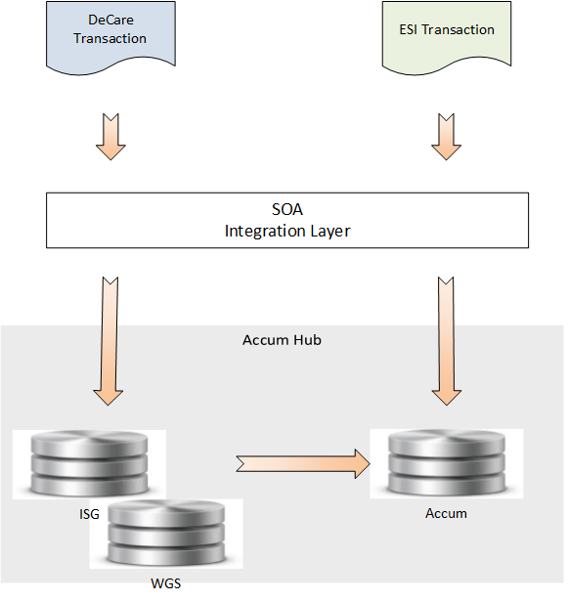
DeCare – Membership Decoupling
Membership decoupling
Problem Statement
DeCare doesn’t pass member contract which is one of the critical data field for Accum update
So member call is done to get the member contract for DeCare transactions
Thus whenever the Membership DBs are not available (during batch transition from R/W to R/O mode), the Accum ODS transactions stall for all consumers
Remove dependency on membership for DeCare by
Decompose from Decare side and call two services, first membership and then ODS
Create separate transactions (creates inconsistency between membership dependent and memberless transactions)
Decompose services during ODS call in service layer
System is available 24/7
Out of synch situations are reduced
Solution Highlights
Benefits
5

Slide 6
Improving Logging/Analytics to Integration Layer
Improve Integration layer
Problem Statement
There are multiple stages in the Accum ODS transactions and the transaction counts at each stage are inaccurate and E2E view of transaction flow is missing.
Introduce Trace logging at the Data power (DP) Gateway and DP DAL tiers to improve transparency.
Improved transparency and easy resolutions for out of synch situations.
Consumer
ODS Integration Layer
Splunk
Logging
DataPower
DAL
BPM Servers
DataPower
Gateway
Solution Highlights
Midrange
MQ
Benefits
Mainframe
MQ
IMS
ODS
CA Mainframe
6

Slide 7
IMSConnect Vs. MQ
IMS connect case study
Comparison
The choice of one solution versus the other is primarily based on the request type.
IMS Connect
A solution for synchronous or remote procedure call types of requests (a.k.a direct connection model)
Applications that use this model are written to interact with a partner application and to react to error conditions such as the partner being unavailable or a connection failure.
WebSphere MQ
A solution for asynchronous requests (aka messaging and queuing model)
Applications that choose this model expect assured delivery of a message it is sending even if the partner or a component in the connection is unavailable. Replies are not necessarily expected.
Case study was done integrating the adaptor in the mainframe server itself using ILF. Accum hub scenario is different, Adaptor is outside mainframe, so the projected savings in the case study may not reflect in our scenario.
IMS connect works well with Synchronous transactions. So since current problem is related to synchronous type transaction, this can be piloted to bench mark the performance constraints involved on the scalability aspect.
Recommendation
7

